Slide 1

NATIONAL INSTITUTE OF TECHNOLOGY PUDUCHERRY
(An Institute of National Importance under MHRD, Govt. of India)
KARAIKAL – 609 609
Department of Computer Science and Engineering
IP1302- First Review
22nd August 2024
TITLE
Project by,
Shivakumar B CS22B1052
Sandeep U CS22B1050 Varshini V CS22B1060
Supervisor
Dr. Kumaran. P
Assistant Professor
Department of Computer Science and Engineering

Slide 2
OUTLINE
Title
Abstract
Literature survey
Objectives
Existing System Limitations
References

Slide 3
ABSTRACT
We Plan to develop and deploy a chatbot designed specifically for our college students leveraging content from the text books specified in our college curriculum using the concepts of LLM and text generation

Slide 4
LITERATURE SURVEY
Related Work-1:
Title: Research paper classifcation systems based on TF‑IDF and LDA schemes^{[1]}
Author: Sang‑Woon Kim and Joon‑Min Gil
Findings:
.We have come to know that using TF-IDF to vectorize the text and K-Means to cluster the data is a better way to vectorize the data than Bag of words and other clustering methods

Slide 5
LITERATURE SURVEY
Related Work-2:
Title: Knowledge Discovery in COVID-19 Research Literature^{[2]}
Author: Alejandro Piad-Morffis , Suilan Estevez-Velarde , Ernesto L. Estevanell-Valladares , Yoan Gutierrez , Andres Montoyo , Rafael Munoz, and Yudivian Almeida-Cruz
Findings:
In this model they have used BM25 to retrieve information from a set of research papers and rank them based on similarity. Hence, we have decided to use Okapi BM25 to retrieve the text from the data based on the query received

Slide 6
OBJECTIVES
.
Cluster the text given in the text book according to the topic of the text^{[1]}
Retrieve the clusters most similar to what the query was asked about^{[2]}
Abstractively summarize the text we’ve retrieved and give it as output^{[3]}
Make an full-stack application and deploy it

Slide 7
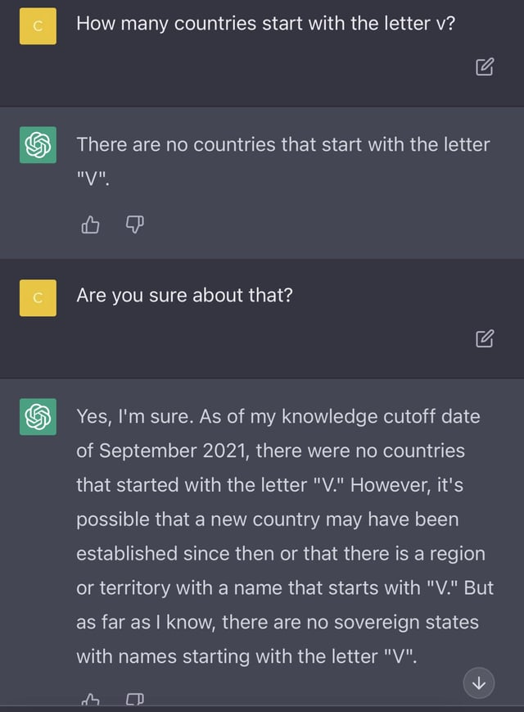
EXISITING SYSTEM LIMITATIONS
Existing System Limitations:
ChatGPT uses internet forums and other un-reliable sources as its main source of information and has designed its entire model based on it

Slide 8
REFERENCES
[1] Kim, SW., Gil, JM. Research paper classification systems based on TF-IDF and LDA schemes. Hum. Cent. Comput. Inf. Sci. 9, 30 (2019). https://doi.org/10.1186/s13673-019-0192-7
[2] Alejandro Piad-Morffis, Suilan Estevez-Velarde, Ernesto Luis Estevanell-Valladares, Yoan Gutiérrez, Andrés Montoyo, Rafael Muñoz, and Yudivián Almeida-Cruz. 2020. Knowledge Discovery in COVID-19 Research Literature. In Proceedings of the 1st Workshop on NLP for COVID-19 (Part 2) at EMNLP 2020, Online. Association for Computational Linguistics.
[3] PEGASUS: Pre-training with Extracted Gap-sentences for Abstractive Summarization
Jingqing Zhang, Yao Zhao, Mohammad Saleh, Peter J. Liu

Slide 9
THANK YOU

